Slide 1
GREAT: Generalized Reservoir Sampling based Triangle Counting Estimation
over Streaming Graphs
Siyue Wu, Dingming Wu*, Sinhong Cheuk, Tsz Nam Chan, Kezhong Lu
College of Computer Science and Software Engineering
Shenzhen University, Shenzhen, China

Slide 2
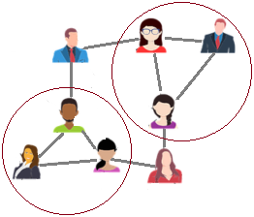
Motivation
Triangle counts application:
network evolution analysis
community detection
anomaly detection
Streaming graph: Real-world dynamic graphs can be modeled as the edge streams. Each coming edge has a unique timestamp.
A stream of edges
t_{n}
t_{n+1}
t_{n+2}
.......
.......
t∞
...
...

Slide 3
Overview of Question
Input: An edge stream.
Output: Global triangle count and local triangle count of each vertex, at any timestamp.
A stream of edges
t_{n+1}
t_{n+2}
.......
.......
t∞
...
...
t_{n}
At timestamp t_{n} , output
Global triangle count:
How many triangles from t₀ to t_{n}
Local triangle count:
How many triangles contained by vertex v from t₀ to t_{n}, for any v ∈ V
A
B
C

Slide 4
Limitation
Restrictions of triangle counting over streaming graphs:
(i) unbounded edge streams
(ii) single-pass processing
Existing Method
(exact counting or most of estimation):
Unlimited memory requirement
Multiple edge processing
Fixed memory based estimations!
Impossible！！！

Slide 5
FM-based Estimations
Fixed memory-based estimations(FM) only require a fixed memory budget k to estimate global and local triangle counts.
Inefficiency:
High computational cost
(at least O(k) for per edge).
GREAT
Inaccuracy:
Ignore dynamic timestamp interval distributions of triangles.
GREAT⁺

Slide 6
FM-based Estimations
A stream of edges size=k
(C-I) Construct a uniform edge sample by Reservoir Sampling(RS).
(C-II) Update the estimated triangle counts according to the edge sample.
...
...
Method I:
estimation before sampling
B
A
A
Edge sampling: p=min{k/t_{uv},1}
B
C
C
C
A
Method II:
estimation after sampling
A
B
Reservoir (fixed size)
B
C
Removing strategy: one randomly
C-II:
triangle counting estimation
C-I: reservoir sampling

Slide 7
GREAT (improve efficiency)
(C-I) Construct an edge sample by Generlized Reservoir Sampling(GRS).
A stream of edges size=k
...
...
B
GREAT^{I} p_{uv}^{(s)}=(1- α) ^{r_uv}
GREAT^{II} p_{uv}^{(s)}=k/t_{uv}
A
Edge sampling: self-defined p
C
estimation before sampling
B
A
C
(C-II) Update the estimated triangle count whenever an edge arrives according to edge sample.
A
Reservoir (fixed size)
B
C
Removing strategy: α-portion
C-II:
triangle counting estimation
C-I: Generalized reservoir sampling
Less edges in the reservior
Less computation cost！！

Slide 8
GREAT⁺ (improve accuracy)
Time interval of a triangle (e₁, e₂, e₃) means the interval between the arrival time of three edges constructed the triangle (t_{e3} - t_{e2}) + (t_{e3} - t_{e1}).
≈
Time interval distribution of
discovered triangle
in the reservoir
Time interval distribution of
triangles
in the edge streams
Triangles more easily discovered
Lower variance !!

Slide 9
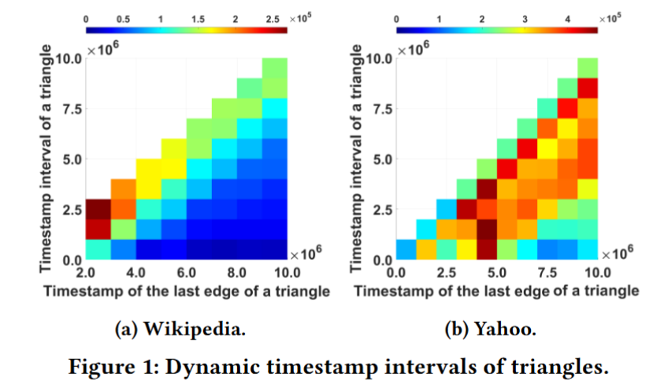
GREAT⁺ (improve accuracy)
Time interval of a triangle (e₁, e₂, e₃) means the sum of the time interval between the arrival of the three edges of a triangle (t_{e3} - t_{e2}) + (t_{e3} - t_{e1}).
Observations from the real-world edge streams:
(i)Non-uniform in most cases. (×TRIẼST)
(ii)Not always biased to short intervals. (×WRS)
(iii)Varies over time.

Slide 10
GREAT+ (improve accuracy)
Larger α (removing portion)
Fewer old edges and more new edges in the reservoir
Triangles with short time intervel more easily discovered
Reservoir
Removing less edges
GREAT⁺ :
I. From the previous discovered triangles to know the time interval distribution over the edge streams.
II. Adaptively set α of GREAT to match the time interval distribution over the edge streams.
Reservoir
Removing more edges

Slide 11
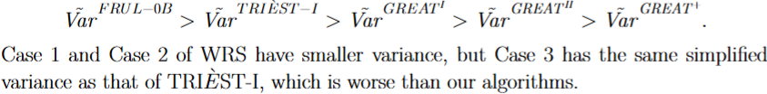
Theoretical Comparison
Accuracy: The state-of-the-art algorithms and our algorithms already guarantee unbiasedness, so we compare simplified variance of each triangle as previous works do.
Efficiency: The edge streams are unlimited, so we compare amortized time of each coming edge.
Sampling: FURL-0B > WRS = TRIẼST=GREAT⁺ = GREAT^{I} = GREAT^{II}
Counting: TRIẼST = WRS = FURL-0B > GREAT⁺ > GREAT^{II} > GREAT^{I}

Slide 12
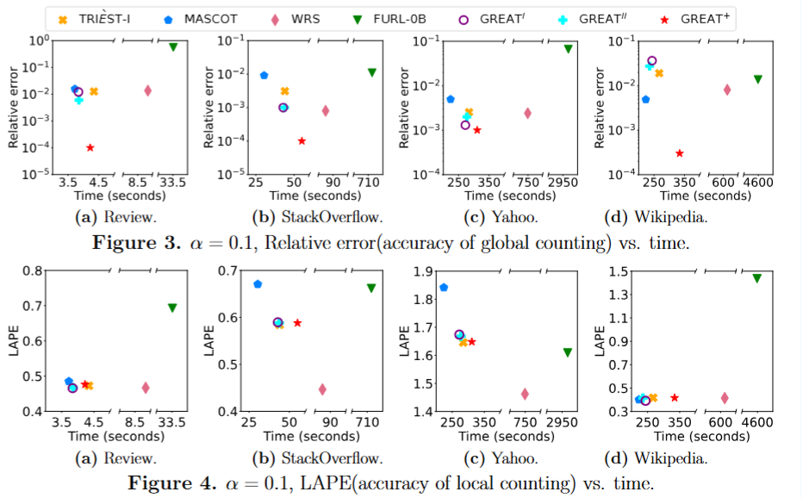
Experimental Comparison
Efficiency: MASCOT is the fastest but it requires unlimited memory. GREAT^{I} and GREAT^{II} are the fastest among FM-based algorithms. GREAT⁺ is slower because of the adaptive strategy.
Accuracy: The accuracy of global counting in GREAT⁺ is the best, while GREAT^{II} and GREAT^{I} is second and third place, respectively. As the number of discovered vertices increases, the accuracy of local triangle counting tends to decrease, therefore, GREAT^{I}, GREAT^{II}, GREAT⁺, and TRIẼST exhibit similar LAPEs. WRS has the best LAPE, but leads to a decrease in efficiency.

Slide 13
Novelty
GREAT: maintain a smaller sample to improve efficiency.
GREAT⁺: combine an adaptive strategy to improve accuracy.

Slide 14



Thank you！
Codes and supplementary materials
Paper

